Slide 1
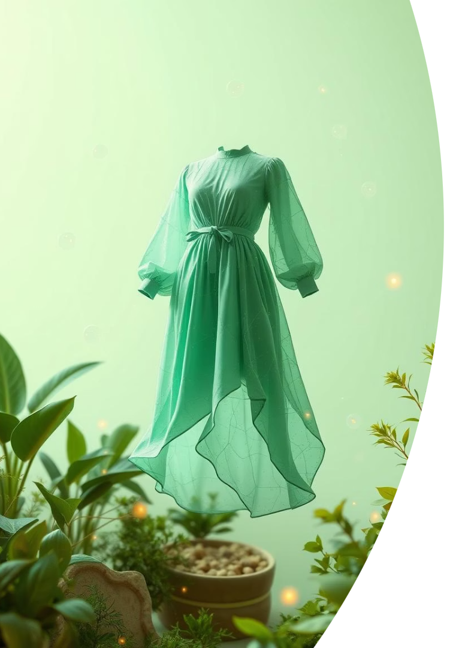
AI Fashion Explorer: Where Creativity Meets Shopping
Welcome to AI Fashion Explorer, a ground-breaking platform that transforms how fashion enthusiasts create, discover, and shop. This innovative tool merges artificial intelligence and user creativity to deliver an unmatched, personalized style journey. Whether you're an aspiring designer or a fashion shopper, our technology empowers your unique vision to come to life instantly. Let’s dive into how this cutting-edge solution is reshaping the future of fashion retail and design.

Slide 2
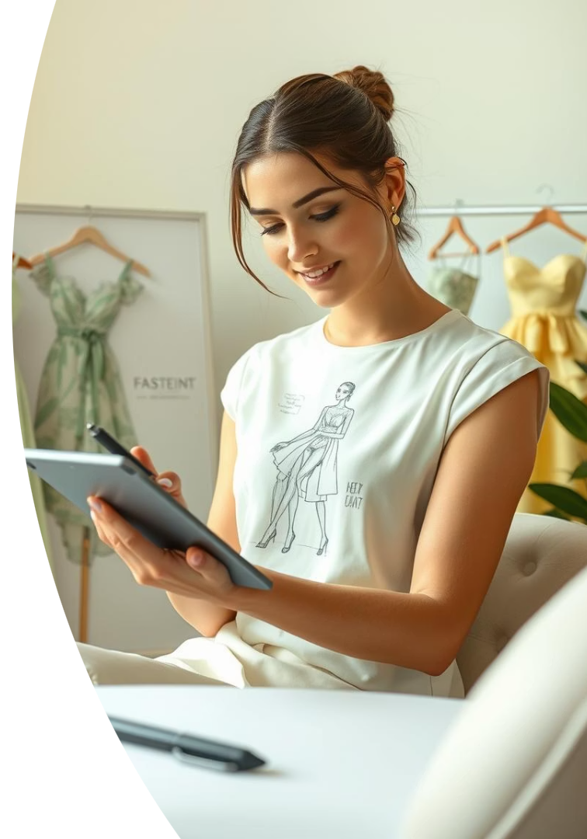



The Vision
Draw or Snap
Capture your inspiration by sketching or photographing a style that speaks to you.
Instant AI Match
Our intelligent engine identifies real products or design ideas aligned with your vision.
Shop or Create
Buy the matched styles or use them to fuel your next fashion creation seamlessly.

Slide 3
Problem & Opportunity
Fashion Discovery is Broken
Massive Opportunity
Text-based search limits exploration and creativity
Harness AI and computer vision to unlock new search paradigms
Users seek inspiration from images, sketches, and visual ideas
Fuse user creativity with technology to revolutionize fashion discovery

Slide 4
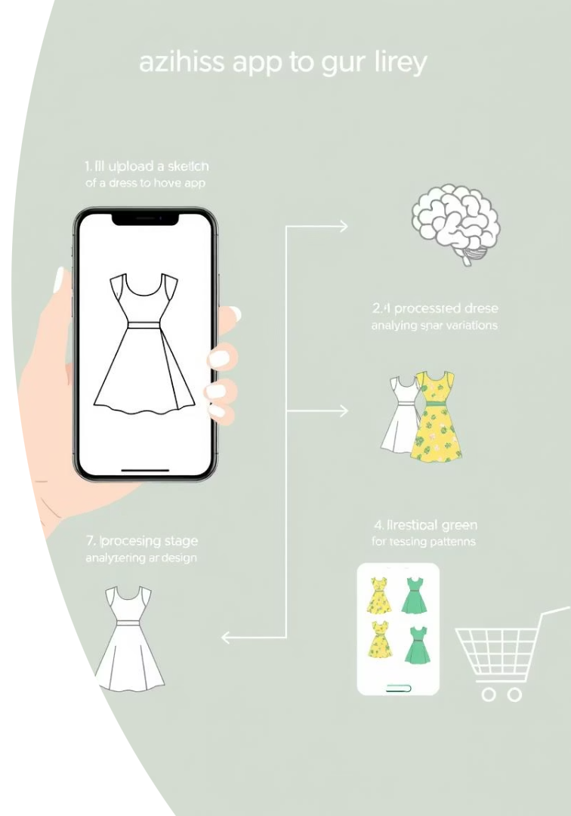
How It Works: User Journey
1
Upload
2
AI Magic
Users submit a photo or sketch of their desired fashion style.
Our AI conducts visual search to find similar styles and generates realistic images from sketches.
3
Discover & Shop
Browse curated options from multiple retailers, compare choices, and make purchases securely.

Slide 5
Core Features
Dual Input Methods
AI-Powered Visual Search
Sketch-to-Dress Image Generation
Upload photos or sketches for personalized fashion search and discovery.
Real-time matching technology delivers precise and relevant results instantly.
Transform creative sketches into photorealistic clothing images to visualize ideas.
Extensive Product Matching
Mobile-Optimized Web Interface
Aggregate products from multiple retailers for a comprehensive shopping experience.
Seamless, intuitive experience designed for modern devices on the go.

Slide 6





Technology Stack
Frontend: React, Tailwind CSS, Next.js
Backend: FastAPI, Python
AI/ML: CLIP, StyleGAN2, Resleeve/NewArc API
Database: PostgreSQL, Elasticsearch
Integrations: Retailer APIs, Affiliate Networks

Slide 7
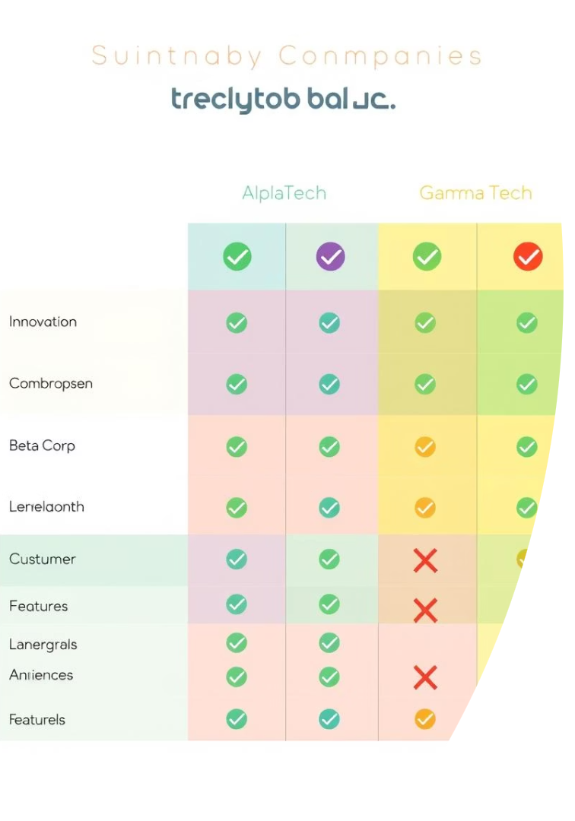
Competitor Analysis Matrix
Platform
Strengths
Weaknesses
Our Advantage
Ximilar
Powerful visual search
No sketch-to-image, B2B focus
Consumer-first, sketch support
Resleeve AI
Fast, realistic sketch renders
Designer-centric, no product search
Unified shopping + creativity
Amazon StyleSnap
Accurate photo search
No sketch input
Sketch-to-product experience
H&M/Myntra
Visual search, recommendations
No creativity tools
User-driven design discovery

Slide 8
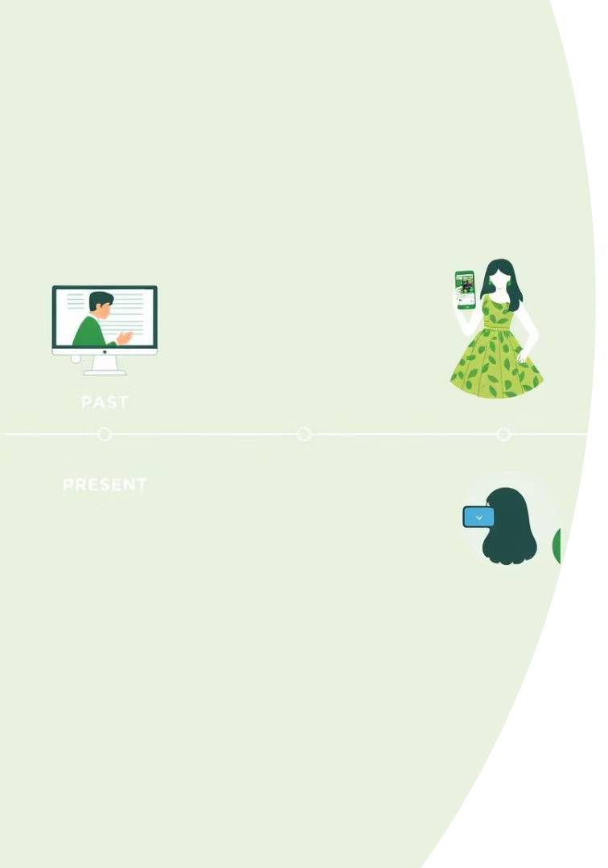
Past, Present, Future
1
Past
Search was text-based and manual curation limited personalization and discovery.
2
Present
Adoption of AI-powered visual search and recommendations has enhanced fashion exploration.
3
Future
Sketch-to-product generation, AR try-ons, and hyper-personalized user experiences are on the horizon.

Slide 9
Implementation Roadmap
Research & Planning
Set goals and lay groundwork in 2-4 weeks for data and tech evaluation.
Data Collection & Preparation
Gather and clean diverse fashion datasets over 3-6 weeks.
Model Development
Train and optimize AI models for 6-8 weeks with iterative testing.
Web Platform Build
Develop the frontend and backend with focus on UX across 8-12 weeks.
Testing & Launch
Comprehensive QA and beta launches followed by public release over 4-6 weeks.
Iterate & Innovate
Continuous improvements and feature expansion remain ongoing.

Slide 10
Future Growth & Impact
Augmented Reality Try-On
Personalized Recommendations
Global Marketplace Integration
Empowering Designers & Shoppers
Enhance shopping by letting users virtually try garments before purchase, increasing confidence and satisfaction.
Leverage AI to deliver tailored fashion suggestions based on individual style and preferences.
Expand access to worldwide fashion brands and independent designers on one unified platform.
Foster creativity and commerce by bridging artists and consumers through innovative technology.

